Slide 1
Hello!!
I’m ERUM SHAHEEN
Where you can find me:
Room#: Female Instructor Room
Email: ERUM.SHAHEEN@nu.edu.pk
Ext: 293

Slide 2
Books and Reference Material
Google class room Code:c7m6nue
TextBook:Data Structures and Algorithms in C++ 4th Edition by Adam Drozdek
Reference Data Structures & Algorithms Made Easy 5th Edition by Narasimha Karumanchi
Data Structures with C by Schaum's series

Slide 3
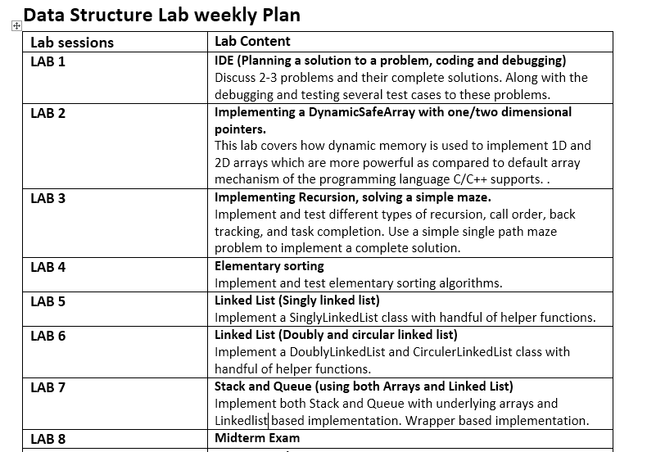
Week Plan

Slide 4
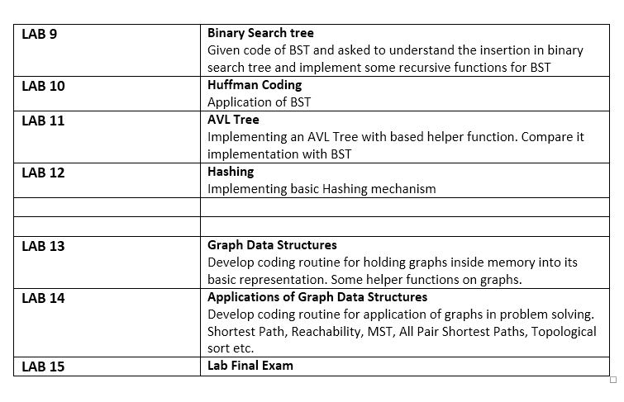

Slide 5
Marks Distribution
Lab Activities:
Mid exam: 25
Lab work: 20
Performance:5
Final: 50
Task submission of current lab will be before next lab.
Late Submission of labs will result in deduction of marks.

Slide 6
Command line Arguments
The main() in C/C++ is a very vital function. It is the main entry point for a program. There will be only one main in a program. It is generally defined with a return type of int and without parameters:
int main() { /* ... */ }
We can also give command-line arguments in C and C++. Command-line arguments are given after the name of the program in command-line shell of Operating Systems.
For Example:C:\Users\Erum\Documents\Untitled1.exe hi this is erum
you have entered 5arguments
hi
this
is
erum

Slide 7
Syntax in Main()
int main(int argc, char *argv[]) { /* ... */ }
OR
int main(int argc, char **argv) { /* ... */ }
argc (ARGument Count) is int and stores number of command-line arguments passed by the user including the name of the program. So if we pass a value to a program, value of argc would be 2 (one for argument and one for program name)
The value of argc should be non negative.
argv(ARGument Vector) is array of character pointers listing all the arguments.
If argc is greater than zero,the array elements from argv[0] to argv[argc-1] will contain pointers to strings
Argv[0] is the name of the program , After that till argv[argc-1] every element is command -line arguments.

Slide 8
Debugging
Whenever you write C++ programs, inevitably you're going to have to debug the program. The series of steps will teach you how to debug a c++ program.
To use Dev C++ IDE for debugging follow the steps below:
Step#01: Write down the code and compile it.
//Write a program to find the greatest of 3 integers.
#include <iostream>
using namespace std;
int main(){
int a =5; int b=6; int c =3;
if( a> b && a < c){
cout << “A is the greatest of all three integers “<< a << endl;
}
else if (b> a && b > c){
cout << “B is the greatest of all three integers “<< b << endl;
}
else {
cout << “C is the greatest of all three integers << c << endl;
}
return 0;
}

Slide 9
Step#02: Enable the debugger using (Tool> Compiler Options> Check (mark) both options and add –g in the first field).
Step#03: Setting a break point: Click on the left side of each statement you want to set a breakpoint. Once you set the break point it will appear as a red circle on the left of statement.
Step#04: Start the debugger: Start the debugging operation using the debug button shown in the bottom left pane of your IDE or press F5.
Step#05: To move on to next line, click the next line button.This will be indicated through a blue arrow on the left of statement. Once you reach the “if condition”, you may now step into it by clicking on the next line. You will see that the debugger will skip the cout statement of “if condition” as it holds false for statement and will directly jump to next condition i.e. else if. If the condition holds true, it will jump into the condition’s body or else skip it. The same will be followed throughout the execution of program. Note: If you click continue, it will keep on going on to the next line as if there are no breakpoints. Into function is used to go into the definition of functions (in case you have implemented some functions in your code, in our case it is main() function.
Step#06: Checking the states of variable during execution. You can hover over the variable or right click the variable to get its intermediate value’s idea.
Step#07: Adding a Watch on Variables. To add a watch you may right click the variable, and choose add watch option shown in the options popup. Once the watch is set, you will see the value of variable in the top left pane of your ide as it changes /progresses in your program execution.
Step#08: Stop Debugger. Click SHIFT + F5.

Slide 10
Q & A

